Slide 1
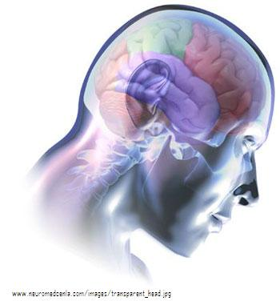
Canadian Neurological Scale (CNS)
2021
Updated Section A1 Scoring of Face – 23 June 2023

Slide 2
Objectives
Upon completion of this information session the learner will be able to:
Identify which neurological scale (CNS or GCS) to use for assessment
Identify the steps of the assessment
Recognize an expressive and receptive deficit
Determine the CNS score of patient scenarios

Slide 3
What is the CNS?
Standardized stroke assessment tool used for stroke (or suspected) and TIA patients
CNS is a validated stroke tool used to assess patients who are drowsy or alert
It is used to:
  determine neurological baseline on admission and to detect deterioration during the acute stay so early interventions can be implemented
  objectively measure the impairment of the patient
Report a decrease of more than 1 point to the most responsible provider

Slide 4
Meaning of CNS Scores
Higher CNS scores (>11) are associated with more favorable outcomes both in the short term & 6 months post stroke
Lower CNS scores (<9) tend to be associated with increased deficits and morbidity rates

Slide 5
Definitions
Alert: awake, alert & normal LOC (use CNS)
Drowsy: rouses when stimulated verbally & remains awake & alert for short periods but dozes (use CNS)
Stuporous: responds to loud verbal stimuli &/or strong touch; may speak but does not completely wake up (use GCS)
Comatose: responds to deep pain with purposeful movement, non-purposeful movement or no response (use GCS)
Speech:
  Receptive Deficit: unable to understand the spoken word
  Expressive Deficit: difficulty communicating thoughts verbally

Slide 6
CNS and GCS
Glasgow Coma Scale
Comatose or stuporous
Validated for COMA
Assesses level of consciousness and best response
Score ranges from 3 - 15
15 = normal
Assesses response
Canadian Neurological Scale
Alert or drowsy
Validated for STROKE
Assesses deficits
Assesses language
Score ranges from 1.5 -11.5
11.5 = no deficit, normal
Assesses function

Slide 7
Glasgow COMA Scale
Quick, simple, reliable method of monitoring level of consciousness
Includes 3 measures:
  Eye opening
  Best Motor Response
  Best Verbal Response
Score ranges from 3-15
  3 represents total unresponsiveness
  15 represents alert and fully responsive
Assesses response to stimulus - not function

Slide 8

Assess Vital Signs and Pupils
The vital signs and pupils are part of the CNS
Important to assess:
  Temperature, pulse, blood pressure and respirations
  Pupils: Record size of the pupils in mm using the pupil scale prior to the application of the light stimulus
    + = brisk, S = sluggish, - = no reaction, C = closed due to swelling

Slide 9

What does the CNS assess?
Two streams:
Section A Mentation (LOC, Orientation & Speech)
AND
Section A1 Motor Function: No Receptive Deficit
        OR
Section A2 Motor Response: Receptive Deficit Present
Tips:
Do not complete both A1 & A2
Section A - guides the nurse to A1 or A2
Notes:
*ensure participants have a copy of the CNS in front of them to refer to
*point out the sections and differentiate one from the other

Slide 10
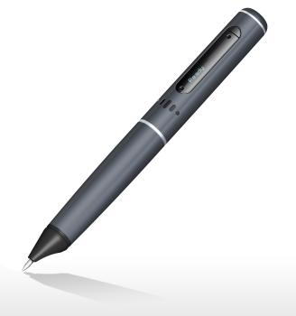
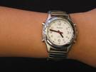
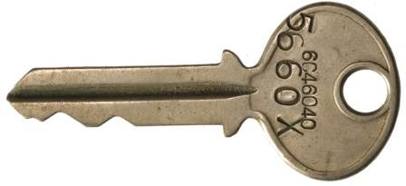
What tools do you need ?
CNS document (paper or electronic)
Flashlight
Key
Watch
Pen/pencil

Slide 11
CNS Section A Mentation
LOC
Orientation
Speech

Slide 12
Section A Mentation: LOC
CNS tool only used on patients who are alert or drowsy
If the patient is stuporous or comatose use the GCS & switch to CNS as soon as patient improves to alert or drowsy
  Score
  Score 3.0 Alert (if the patient has a normal level of consciousness)
  Score 1.5 Drowsy (if the patient rouses when stimulated verbally and
  remains awake and alert for short periods but tends to doze)

Slide 13
Section A Mentation: Orientation
Ask patient to identify verbally or in writing:
Place (city or hospital)
Time (month and year)
Score
1.0 Oriented, if patient gets both place & time correct
0.0 Disoriented, if one or both are incorrect
Tips:
Patient may write answers
Do not ask patient day of the week or date of the month

Slide 14
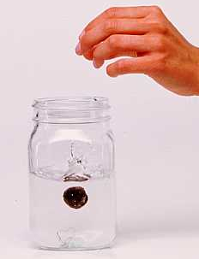

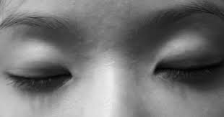

Section A Mentation: Speech (Receptive)
Always begin with Receptive Speech assessment
Ask patient:
To “close your eyes”
To “point to the ceiling”
“Does a stone sink in water?”(not all organizations require this question)
Score
0.0 if the patient responds incorrectly to any of the above and go to Section A2 Motor Response: Receptive Deficit Present.
If the patient responds correctly to all of the above proceed to Expressive Speech Assessment
Tips:
Always begin with Receptive Speech assessment.
Do not prompt by gesturing with face or hands

Slide 15
Section A Mentation: Speech (Expressive)
Present patient with 3 items (one at a time - watch, key, pen) and ask patient to:
First identify each item and then identify use of object
Score
1.0 Normal Speech if patient identifies each item AND its use (intelligible slurred speech record “SL”) and Go to Section A1: Motor Function: No Receptive Deficit
0.5 Expressive Deficit if patient unable to identify and state use of all objects and Go to Section A1: Motor Function: No Receptive Deficit
Tips:
If answers CORRECT but slurred, document Normal & put SL in the box.

Slide 16
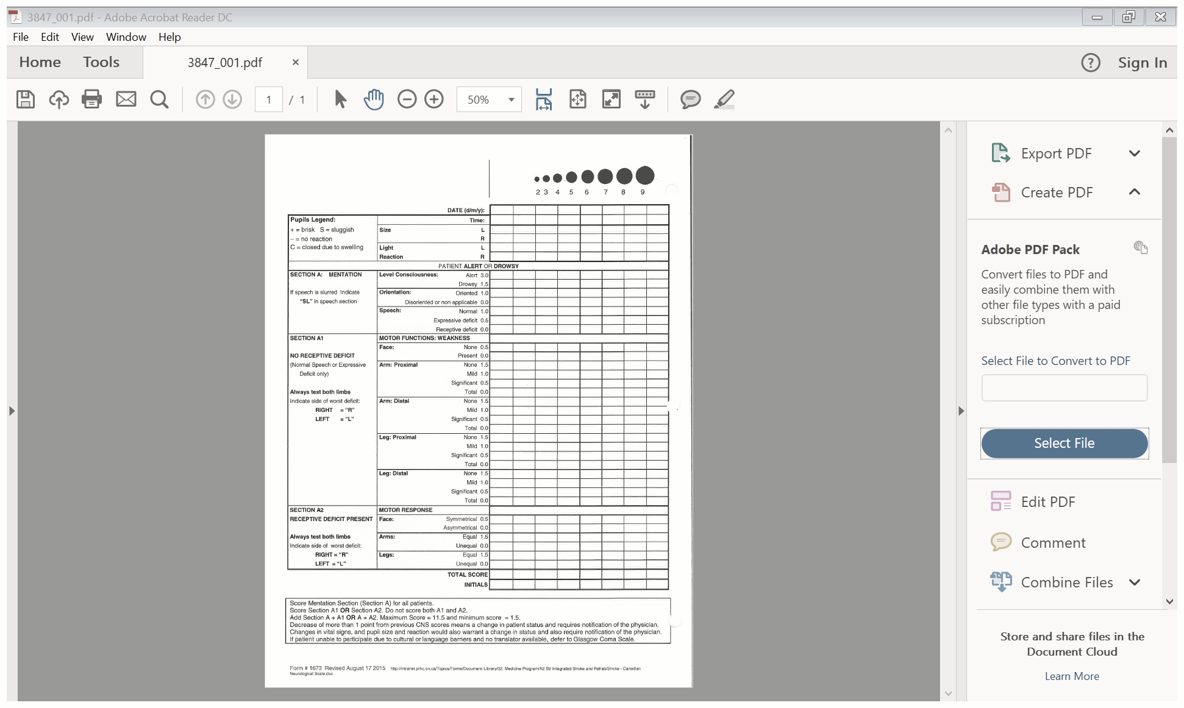

Section A1 Motor Function: No Receptive Deficit
OR
Section A2 Motor Response: Receptive Deficit Present
Critical decision-making point:
  Does your patient have an expressive or a receptive language deficit?
Expressive?
Go to A1!
Receptive?
Go to A2!
Notes:
Normal language also proceeds to A1.
Complete either or, NOT BOTH!
If weakness is present, identify which side has the weakness with "R" or "L" in the slot with the grade, e.g.: R -0.5.
The CNS is meant to identify changes in motor function in the acute stroke patient.
Identify a pre-existing deficit/disability that is not on the side of the new stroke on the CNS form and score the deficit related to the new motor deficit.
e.g. right sided significant deficit or right sided amputation etc.
When evaluating strength and range of motion in limbs always test both sides of the body, record the worst deficit identified and the side of the body the deficit is in.
The Canadian Neurological Scale is meant to identify changes in motor function in the acute stroke patient. If on admission it is identified that the patient has a pre-existing permanent deficits related to a previous stroke or other medical condition, e.g. right sided significant deficit or right sided amputation etc, that is not on the side of the new stroke motor deficit indicate this on the Canadian Neurological Scale form and score the deficit related to the new motor deficit.

Slide 17
Section A1 Motor Function: No Receptive Deficit
Patient does not have a receptive deficit (can follow commands)
Normal or Expressive Speech deficit may be present
Do not demonstrate for patient, use verbal commands only
When assessing motor function the side with the worst deficit is recorded using: “R” for right side and “L” for left side
Tips:
Do not document in Section A2: Motor Response: Receptive Deficit

Slide 18
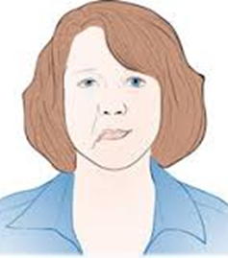

Section A1: Motor Function No Receptive Deficit
FACE
Ask patient to smile or grin, note weakness in mouth or nasal/labial folds
Score
0.5 if no weakness present
0.0 if weakness present (identify which side “R” or “L”)
Tips:
Weakness should correspond to the lesion in the brain (a right middle cerebral infarct,
weakness should be on the left). If not check for previous history of stroke.

Slide 19
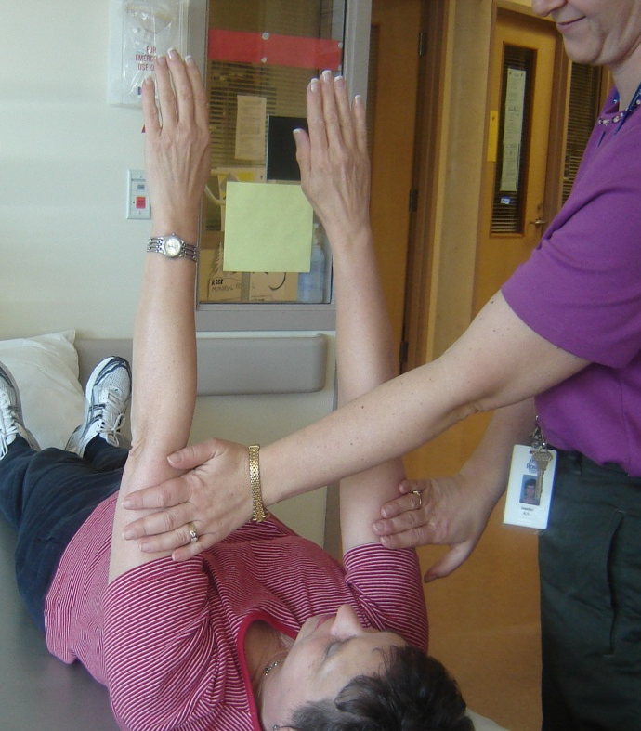
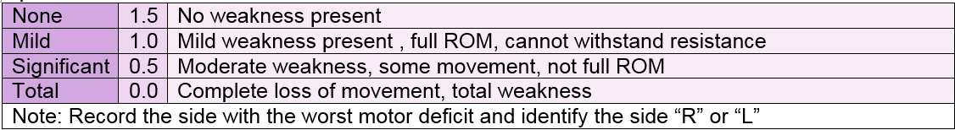
Section A1: Motor Function No Receptive Deficit
ARM: PROXIMAL
Ask patient to lift arms to 45 to 90°. Apply resistance between shoulder and elbow
Score

Slide 20
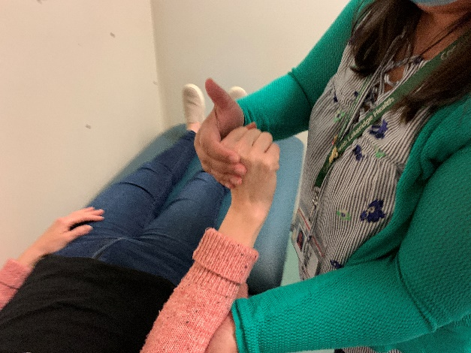
Section A1: Motor Function No Receptive Deficit
ARM: DISTAL
Ask patient to make a fist (dorsiflex hands)
Apply resistance to wrists while stabilizing patient’s arm
Score

Slide 21
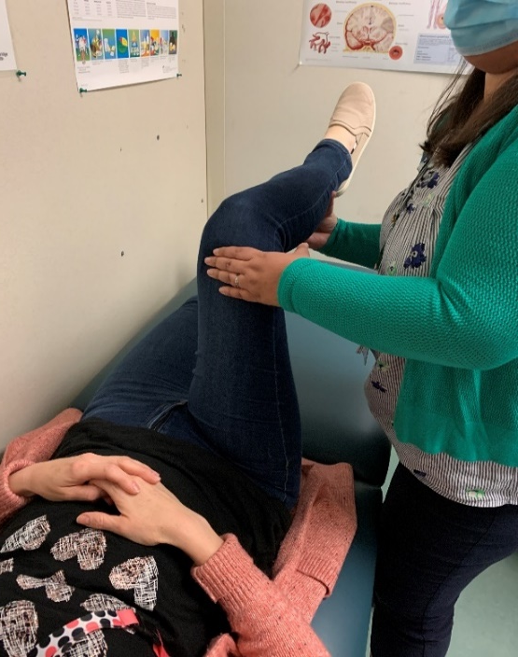

Section A1: Motor Function No Receptive Deficit
LEG: PROXIMAL
In supine, ask patient to flex thighs toward trunk with knees flexed to 90 degree
Apply pressure to mid-thigh
Score
Tips:
Mild 1.0- can assume position but limb may drift and will not withstand applied resistance
Significant 0.5 – may move leg on the bed but will be unable to assume the position

Slide 22
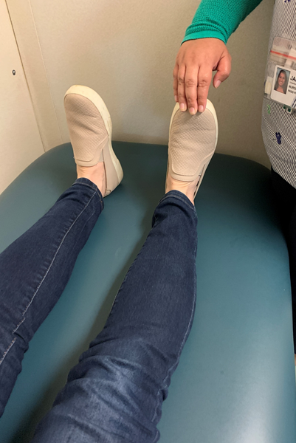
Section A1: Motor Function No Receptive Deficit
LEG: DISTAL
In supine, ask patient to point toes and foot upward (dorsiflex foot), apply resistance to top of foot
Score
Tips:
1.0 = Mild (can point foot & toes upward but unable to oppose pressure)
0.5 = Significant (some movement of toes, but cannot lift toes or foot)

Slide 23

Assessment Completed
Add Score
(Section A: Mentation AND Section A1: Motor Function No Receptive Deficit)

Slide 24
Section A2: Motor Response Receptive Deficit Present
Patient does have comprehension deficits
Patient does NOT understand verbal commands
When assessing motor function the side with the worst deficit is recorded using: “R” for right side and “L” for left side
Tips:
Use demonstration, gestures instead of words.
Do not document in Section A1: Motor Function: No Receptive Deficit

Slide 25
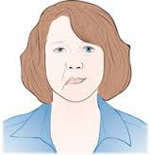
Section A2: Motor Response Receptive Deficit Present
FACE
Have patient mimic your smile or grin. If patient is unable to follow commands, observe facial response when pressure is applied to sternum
Score
0.5 Symmetrical – symmetry of mouth and nasal labial folds
0.0 Asymmetrical – facial asymmetrical, facial weakness on one side

Slide 26
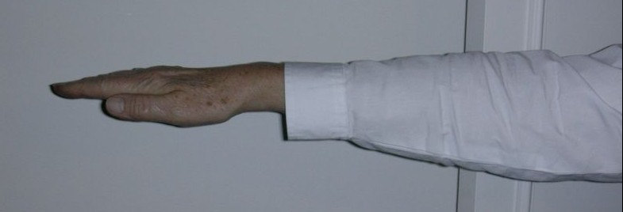
Section A2: Motor Response Receptive Deficit Present
ARMS
Demonstrate or lift patient’s arms to 90 degree, score ability to maintain equal levels (>5 secs)
If patient unable to maintain raised arms, apply nail bed pressure to assess reflex response
Score:
1.5 if equal motor response (symmetrical)
0.0 if unequal motor response (asymmetrical)

Slide 27

Section A2: Motor Response Receptive Deficit Present
LEG
Lift patient’s hip to 90 degrees, score ability to maintain equal levels (>5 secs)
If unable to maintain raised position, apply nail bed pressure to assess reflex response
Score
1.5 if equal motor response
0.0 if unequal motor response

Slide 28

Assessment Completed
Add Score
(Section A: Mentation AND Section A2: Motor Response Receptive Deficit Present)

Slide 29
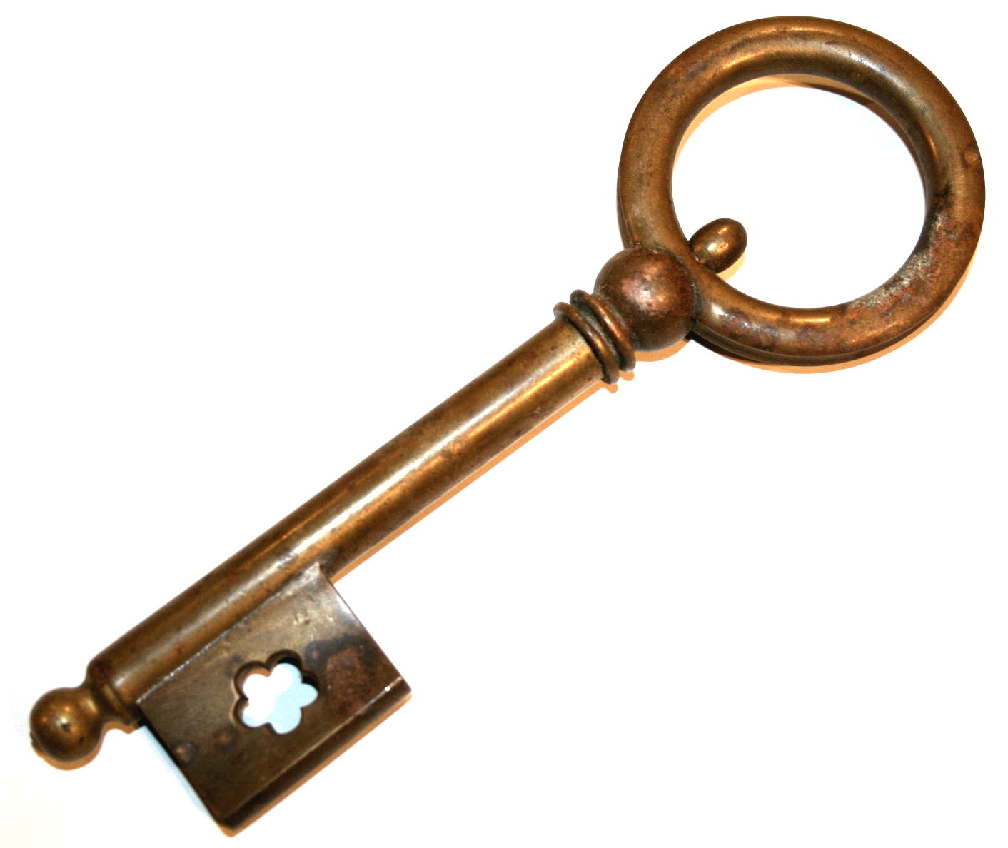
Key Points
Assess both sides, only document affected side
ONLY complete A1 or A2 never both
Only use standardized tools to ensure consistency: pen,
key, watch
Maximum score 11.5 (no deficits)
Minimum score 1.5
Does not assess cerebellar or brain stem infarcts

Slide 30
A decrease of more than 1 point from previous Canadian Neurological Scale may indicate deterioration in the patient’s condition and requires notification of the physician
Notes:
Remember: a change in vital signs and/or pupil size also warrants a physician’s attention

Slide 31
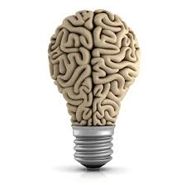

CNS
Case Studies

Slide 32
Case Study A
3
3
+
+
3.0
Pupils 3mm and brisk bilaterally
Patient is awake and alert
Keeps asking “where am I”
Not following commands
Mild right-sided facial weakness
Able to move right arm and leg (proximal and distal), but unable to move it off the bed
0.0
0.0
0.0 R
0.0 R
0.0 R
3.0
Notes:
Level of Consciousness: 3 (alert)
Orientation: 0 (“where am I”)
Speech: 0 (receptive, not following commands)
GO TO A2!
Face: 0 R
Arms: 0 R
Legs: 0 R
Total score = 3

Slide 33
Case Study B
4
4
+
Pupils brisk, 4mm bilaterally
Patient is alert and oriented
Oriented to place and time
Follows commands
Difficulty finding words; not responding appropriately to questions
No facial weakness
Able to move right arm and leg(proximal and distal) into position, but will drift down to the bed with resistance
+
3.0
1.0
0.5
0.5
1.0 R
1.0 R
1.0 R
1.0 R
9
Notes:
Level of consciousness: 3 (alert)
Orientation: 1
Speech: 0.5 (Expressive)
GO TO A1
Face: 0.5
Arm proximal: 1.0
Arm distal: 1.0
Leg proximal: 1.0
Leg distal 1.0
Total score: 9

Slide 34
Case Study C
3
3
+
+
Pupils 3mm and brisk bilaterally
Patient is sleeping when you enter the room, and continues to nod off during the exam
He rouses easily to his name
Speech is slurred, but comprehensive,
oriented
Follows commands
Patient has a left-sided facial droop
Patient cannot move left arm or leg (proximal and distal); immediately fall to the bed when raised by examiner
1.5
1.0
1.0
0.0 L
+
0.0 L
0.0 L
0.0 L
3.5
Notes:
Level of consciousness: 1.5 (drowsy)
Orientation: 1.0
Speech: 1.0 SL
GO TO A1
Face: 0L
Arms proximal: 0.0 L (total)
Arms distal: 0.0 L
Leg proximal: 0.0 L
Leg distal: 0.0 L
Total score: 3.5

Slide 35
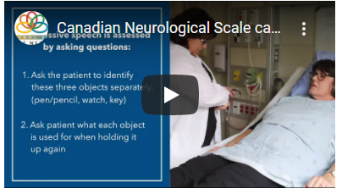
Resources
Stroke Engine: https://strokengine.ca/en/assessments/canadian-neurological-scale-cns/
CESN Case Examples Video: Canadian Neurological Scale case examples – YouTube
Heart & Stroke CNS Training Video: Canadian Neurological Scale Training – YouTube
Scoring template (paper version) - https://strokengine.ca/wp-content/uploads/2020/07/canadian-neurological-scale_strokecenter.pdf

Slide 36

Questions

